Slide 1
Agenda Day 3
Advantages of Apache Spark for big data processing.
Understanding Spark architecture (RDDs, dataframes, datasets).
Hands-on Lab: Setting up a Spark environment and working with Spark RDDs for basic operations.
Using Spark SQL for querying structured data stored in HDFS or data warehouses.
Performing data analysis tasks like filtering, grouping, and aggregation with Spark SQL.
Hands-on Lab: Querying sample datasets using Spark SQL to extract insights.
Visualization

Slide 2
Assignment
Identify some of the challenges in Retail Industry and identify analytical solution.
For one of the analytical solution write code with pandas, numpy and matplotlib.
Install Jupyter on local machine and run the above program.

Slide 3
Spark
Apache Spark is a powerful open-source unified analytics engine for large-scale data processing.
It tackles the limitations of traditional data processing tools by offering speed and scalability for handling big data.
Spark's distributed processing capabilities make it ideal for working with datasets that wouldn't fit on a single machine.
Designed for in-memory processing, enabling faster computations compared to traditional disk-based processing.

Slide 4
Spark
Offers fault tolerance, meaning it can recover from failures without losing data.
Supports various programming languages (Java, Scala, Python, R) through APIs, making it developer-friendly.
Well-suited for various data processing tasks, including:
Batch data processing (historical data analysis)
Real-time data processing (streaming data analysis)
Machine learning
Graph processing

Slide 5
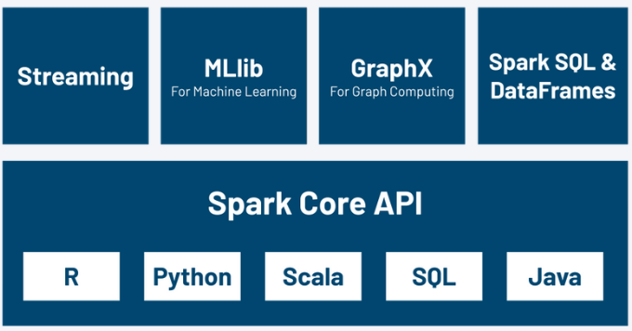
Spark

Slide 6
Install Spark
https://www.sundog-education.com/spark-python/

Slide 7
Spark Core
Spark Core is the foundation of the Apache Spark platform, providing the basic functionality for distributed data processing in a cluster environment. It includes distributed task scheduling, fault recovery, memory management, and interacting with various storage systems.
Distributed Computing Engine:
Spark Core is a distributed computing engine that allows you to perform parallel data processing on large datasets across a cluster of machines. It abstracts away the complexity of distributed computing, enabling developers to focus on their application logic.

Slide 8
Spark Core
Resilient Distributed Dataset (RDD):
RDD is the fundamental data abstraction in Spark, providing an immutable, distributed collection of objects that can be operated on in parallel. Spark Core provides APIs to create, transform, and manipulate RDDs.
Task Scheduling:
Spark Core includes a task scheduler that distributes tasks across worker nodes in the cluster. It optimizes task scheduling based on data locality, minimizing data movement across the network and improving performance.

Slide 9
Spark Core
Memory Management:
Spark Core includes a distributed memory abstraction called Resilient Distributed Datasets (RDDs). RDDs can persist data in memory across multiple operations, enabling fast iterative processing and interactive queries.
Fault Tolerance:
Spark Core provides fault tolerance through RDD lineage. If a partition of an RDD is lost due to a node failure, Spark can reconstruct the lost partition by re-executing the transformations that led to its creation. This ensures the resilience of Spark applications against failures.

Slide 10
Spark Core
Interoperability:
Spark Core interoperates with other components of the Spark ecosystem, such as Spark SQL, Spark Streaming, MLlib, and GraphX. This allows users to build complex data processing pipelines using different Spark APIs.
Extensibility:
Spark Core is extensible, allowing developers to build custom components and integrate them with Spark. It provides APIs in multiple programming languages, including Scala, Java, Python, and R, making it accessible to a wide range of developers

Slide 11
Spark SQL
Spark SQL is a component of Apache Spark that enables developers to work with structured data using SQL or DataFrame APIs. It extends the Spark RDD abstraction to support structured data processing, providing better optimization opportunities and more expressive APIs.
Structured Data Processing:
Spark SQL enables you to work with structured data, such as tables in a relational database or datasets in a tabular format, using SQL queries or DataFrame APIs. This makes it easier to analyze structured data and perform common data manipulation tasks.

Slide 12
Spark SQL
SQL Support:
Spark SQL provides a SQL interface for querying structured data using standard SQL syntax. You can run SQL queries directly against Spark SQL tables, external databases, or other data sources supported by Spark.
DataFrame API:
In addition to SQL queries, Spark SQL provides a DataFrame API for working with structured data programmatically. DataFrames are distributed collections of data organized into named columns, similar to tables in a relational database. DataFrame operations are expressive, allowing you to perform common data manipulation tasks like filtering, grouping, joining, and aggregating data.

Slide 13
Spark SQL
Optimization:
Spark SQL includes a query optimizer that optimizes SQL queries and DataFrame operations for better performance. It applies various optimizations, such as predicate pushdown, column pruning, and partition pruning, to minimize data movement and improve query execution speed.
Unified Data Processing:
Spark SQL integrates seamlessly with other components of the Spark ecosystem, such as Spark Core, Spark Streaming, MLlib, and GraphX. This allows you to build end-to-end data processing pipelines that combine batch processing, real-time stream processing, machine learning, and graph analytics using a unified framework.

Slide 14
Spark SQL
Datasource API:
Spark SQL provides a Datasource API that allows you to read and write data from a variety of data sources, including JSON, Parquet, Avro, JDBC, and Hive. You can define custom Datasources to work with other data formats or external systems.
Compatibility:
Spark SQL is compatible with existing Apache Hive installations, allowing you to run existing Hive queries and UDFs (User Defined Functions) directly on Spark. This provides a smooth migration path for organizations using Hive for data warehousing and analytics.

Slide 15
Spark Streaming
Designed for processing real-time data streams. It offers:
Micro-batch processing: Processes data in small chunks (micro-batches) for near real-time analysis.
DStreams (Discretized Streams): Represent data streams divided into micro-batches.
Windowing operations: Allow analyzing data within specific time intervals over a continuous stream.

Slide 16
MLlib (Machine Learning lib)
Spark's machine learning library offering:
A collection of common machine learning algorithms (linear regression, decision trees, clustering).
Scalable algorithms that can be trained on large datasets distributed across a cluster.
APIs for building, training, evaluating, and deploying machine learning models.

Slide 17
Working Together
These core components work together seamlessly to handle various data processing needs:
Spark Core provides the distributed processing engine.
Spark SQL allows structured data analysis within Spark applications.
Spark Streaming processes real-time data using the core engine.
MLlib leverages Spark's distributed capabilities for scalable machine learning.

Slide 18
Master-Slave Architecture
Spark follows a master-slave architecture with distinct roles:
Driver: The program running your Spark application logic. It submits tasks to the cluster and coordinates their execution.
Executors: Processes are launched on worker nodes in the cluster to execute Spark tasks in parallel.
Worker Nodes: Machines in the cluster that host executors and provide the processing power for your Spark application.

Slide 19
Resilient Distributed Datasets (RDDs)
RDD (Resilient Distributed Dataset) is the fundamental data structure in Apache Spark, designed for distributed processing across a cluster of machines. It represents an immutable collection of objects that can be operated on in parallel.
Distributed:
RDDs are distributed across multiple nodes in a cluster, allowing Spark to perform parallel processing on large datasets. Each RDD is divided into partitions, with each partition stored on a different node in the cluster.

Slide 20
Resilient Distributed Datasets (RDDs)
Resilient:
RDDs are resilient to failures because they can be reconstructed from lineage information (the sequence of transformations used to build the RDD). If a partition is lost due to a node failure, Spark can recompute it using the lineage information.
Dataset:
RDDs represent datasets that can be transformed and manipulated using parallel operations. These operations include transformations (e.g., map, filter, reduceByKey) and actions (e.g., count, collect, saveAsTextFile).

Slide 21
Resilient Distributed Datasets (RDDs)
Immutable:
RDDs are immutable, meaning once created, their contents cannot be changed. However, you can apply transformations to create new RDDs based on existing ones.
Lazy Evaluation:
Spark uses lazy evaluation, meaning transformations on RDDs are not executed immediately. Instead, Spark builds up a directed acyclic graph (DAG) of transformations, and actions trigger the execution of the DAG.

Slide 22
Resilient Distributed Datasets (RDDs)
Type-agnostic:
RDDs can hold any type of data, including primitive types, objects, or even other RDDs.
Interoperability:
RDDs can interoperate with other Spark APIs, such as Spark SQL, Spark Streaming, and MLlib. This allows seamless integration of different components within the Spark ecosystem.

Slide 23
Real-world use cases showcasing Spark's applications
Finance:
Fraud Detection: Analyzing large transaction datasets in real-time to identify and prevent fraudulent activities. Spark can process vast amounts of data quickly, enabling real-time fraud scoring and risk assessment.
Customer Segmentation: Analyzing customer behavior and demographics to create targeted marketing campaigns. Spark helps cluster customers based on spending habits and preferences, leading to more effective marketing strategies.

Slide 24
Real-world use cases showcasing Spark's applications
Retail:
Personalized Recommendations: Recommending products to customers based on their purchase history and browsing behavior. Spark processes large datasets of customer interactions, enabling real-time personalized recommendations that boost sales.
Supply Chain Optimization: Analyzing logistics data to optimize inventory management and delivery routes. Spark can handle complex data sets from various sources, allowing for efficient supply chain planning.

Slide 25
Real-world use cases showcasing Spark's applications
Healthcare:
Genome Sequencing Analysis: Processing large datasets of genomic data to identify genetic variations and diagnose diseases. Spark's distributed processing capabilities help analyze complex genetic information efficiently.
Drug Discovery: Analyzing vast amounts of clinical trial data and patient records to accelerate drug discovery and development. Spark can identify patterns and trends in medical data to support research efforts.

Slide 26
Real-world use cases showcasing Spark's applications
Telecommunications:
Network Analytics: Analyzing network traffic data to identify network anomalies and potential outages. Spark can process massive datasets in real-time, enabling proactive network monitoring and troubleshooting.
Customer Churn Prediction: Identifying customers at risk of churning (canceling service) to develop targeted retention strategies. Spark helps analyze customer data to predict churn and implement retention campaigns.

Slide 27
Real-world use cases showcasing Spark's applications
Spark's ability to handle diverse data formats (structured, semi-structured, unstructured) makes it suitable for various data sources.
Its real-time processing capabilities enable near real-time insights and decision-making.
Spark can be integrated with other big data tools and platforms, offering a comprehensive big data processing ecosystem.
By leveraging Spark's power, organizations can unlock valuable insights from their data, improve operational efficiency, and gain a competitive edge.

Slide 28
Exercise
https://github.com/arjunachari12/big-data-analytics-basics/tree/main/day3

Slide 29
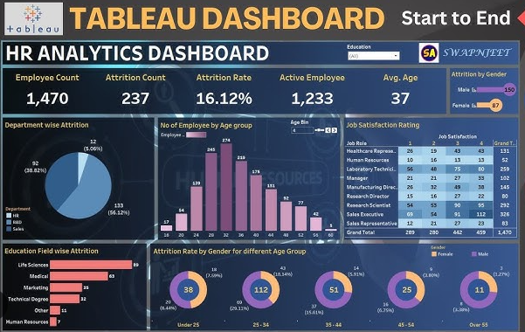
Visualization: Tableau

Slide 30
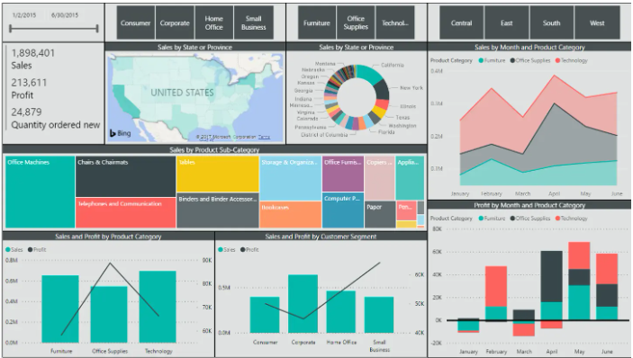
Visualization: Power BI

